Slide 1
Predicting Average Monthly Electricity Price of Residential Sector in US
Prediction of Electricity Price Using Time Series Algorithms
Benhur Tedros

Slide 2
Annually, US electric power industry provides electricity to residential, commercial, and industrial, transportation sectors and others. The electricity price has been varying from state to state, and from year to year.

Slide 3
The Problem
As the change in the electricity price affects people's life, prediction of future electricity price is helpful in visualizing the overall rates for grid electricity and finding out alternative options.
The trend of electricity price has been appeared to increase in the last 20 years.

Slide 4
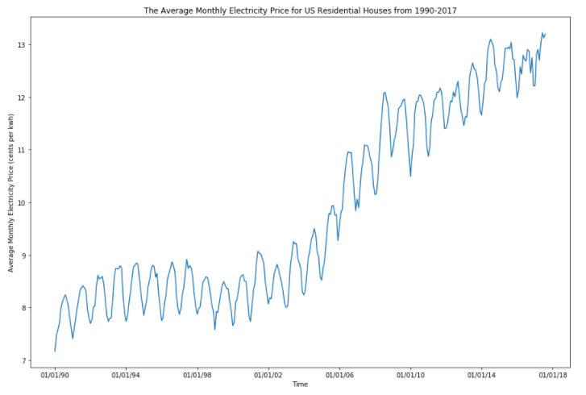
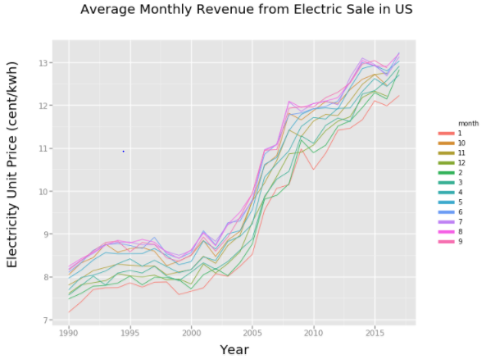
DATA

Slide 5
The Solution
Improvement the efficiency of grid electricity
Finding alternative options and electricity sources
The electric source [gasoline, coal, renewables..] varies from state and state, so does the electric price.

Slide 6
Methods
DATA WRANGLING
MODEL EVALUATION & RESULTS
Time based electricity prices data [1990-2017] from U.S. Energy Information Administration is wrangled and cleaned.
Applying selected model to the validating dataset and evaluate the model performance
Visualize the result
STATIONARITY AND SEASONALITY IN THE DATASET
BUILD TIME SERIES MODEL
Split validating dataset from the original
Split the non-validating dataset into training and testing dataset
C) ARIMA models are fitted to the training dataset and tested on testing dataset to select better model
Checking stationarity using rolling statistics or Dickey-Fuller test
Differencing the values to remove the seasonality, and again check its stationarity

Slide 7
MODEL UTILIZED : ARIMA MODEL
Moving Average (MA)
Model that utilizes the dependency between an observation and a residual error from a moving average model applied to lagged observation
AutoRegressive (AR)
ARIMA
Combination of AutoRegressive and Moving Average and adds the notion integration
Model that uses the dependent relationship between an observation and some number of lagged observations

Slide 8
MODEL SELECTION
Moving Average (MA)
RSME: 0.3364
AutoRegressive (AR)
RSME: 0.3540
ARIMA
RSME: 0.3519

Slide 9
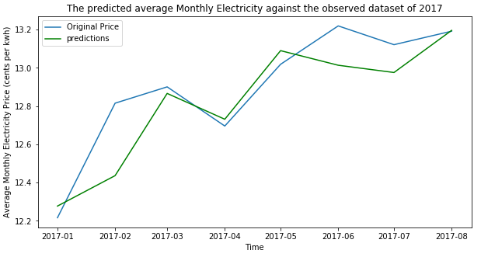
Results
RSME: 0.1653 cents per kwh

Slide 10
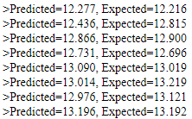
Predicted Vs Observed electricity price of Validating Dataset
Validating dataset: the average monthly electricity price for the year of 2017. It includes the months from January to August. This dataset was used for the model evaluation

Slide 11
Client Recommendations
Utilize the model for future forecast of average monthly residential electricity price with an error of 0.1653 cents/kwh
Continue further research on State-based prediction normalized by the source running the grid electricity
State based prediction would be helpful and more effective
1
2
3

